Slide 1



GuruFinder - A tutor finding application
Presented By –
Runesh Gazane (229031)
Saurav Patil (229086)

Slide 2
Introduction
GuruFinder is a modern web-based platform designed to connect students with qualified tutors who can help them improve their academic performance.
In today's competitive academic environment, many students need extra help to succeed in their studies, and finding the right tutor can be a challenging task.
This application is a one-stop solution that simplifies the process of finding the right tutor. It is designed to provide a seamless and efficient experience for both students and tutors, helping them to achieve their academic goals. With this application, students can easily access the support they need to succeed in their studies, and tutors can reach out to a wider audience to offer their services.

Slide 3
Objective
GuruFinder aims to provide a seamless and efficient way for students to find the best tutors to enhance their academic performance while also offering tutors an opportunity to reach out to a wider audience to offer their services.

Slide 4
Technologies Used
Front End : React
Backend : Spring Boot
Database : MySQL

Slide 5
UML Diagrams
E-R Diagram
Activity Diagrams (Admin, Tutor, Students)
Use Case Diagrams (Admin, Tutor, Students)
Data Flow Diagrams (Admin, Tutor, Students)
Sequence Diagram for Login

Slide 6
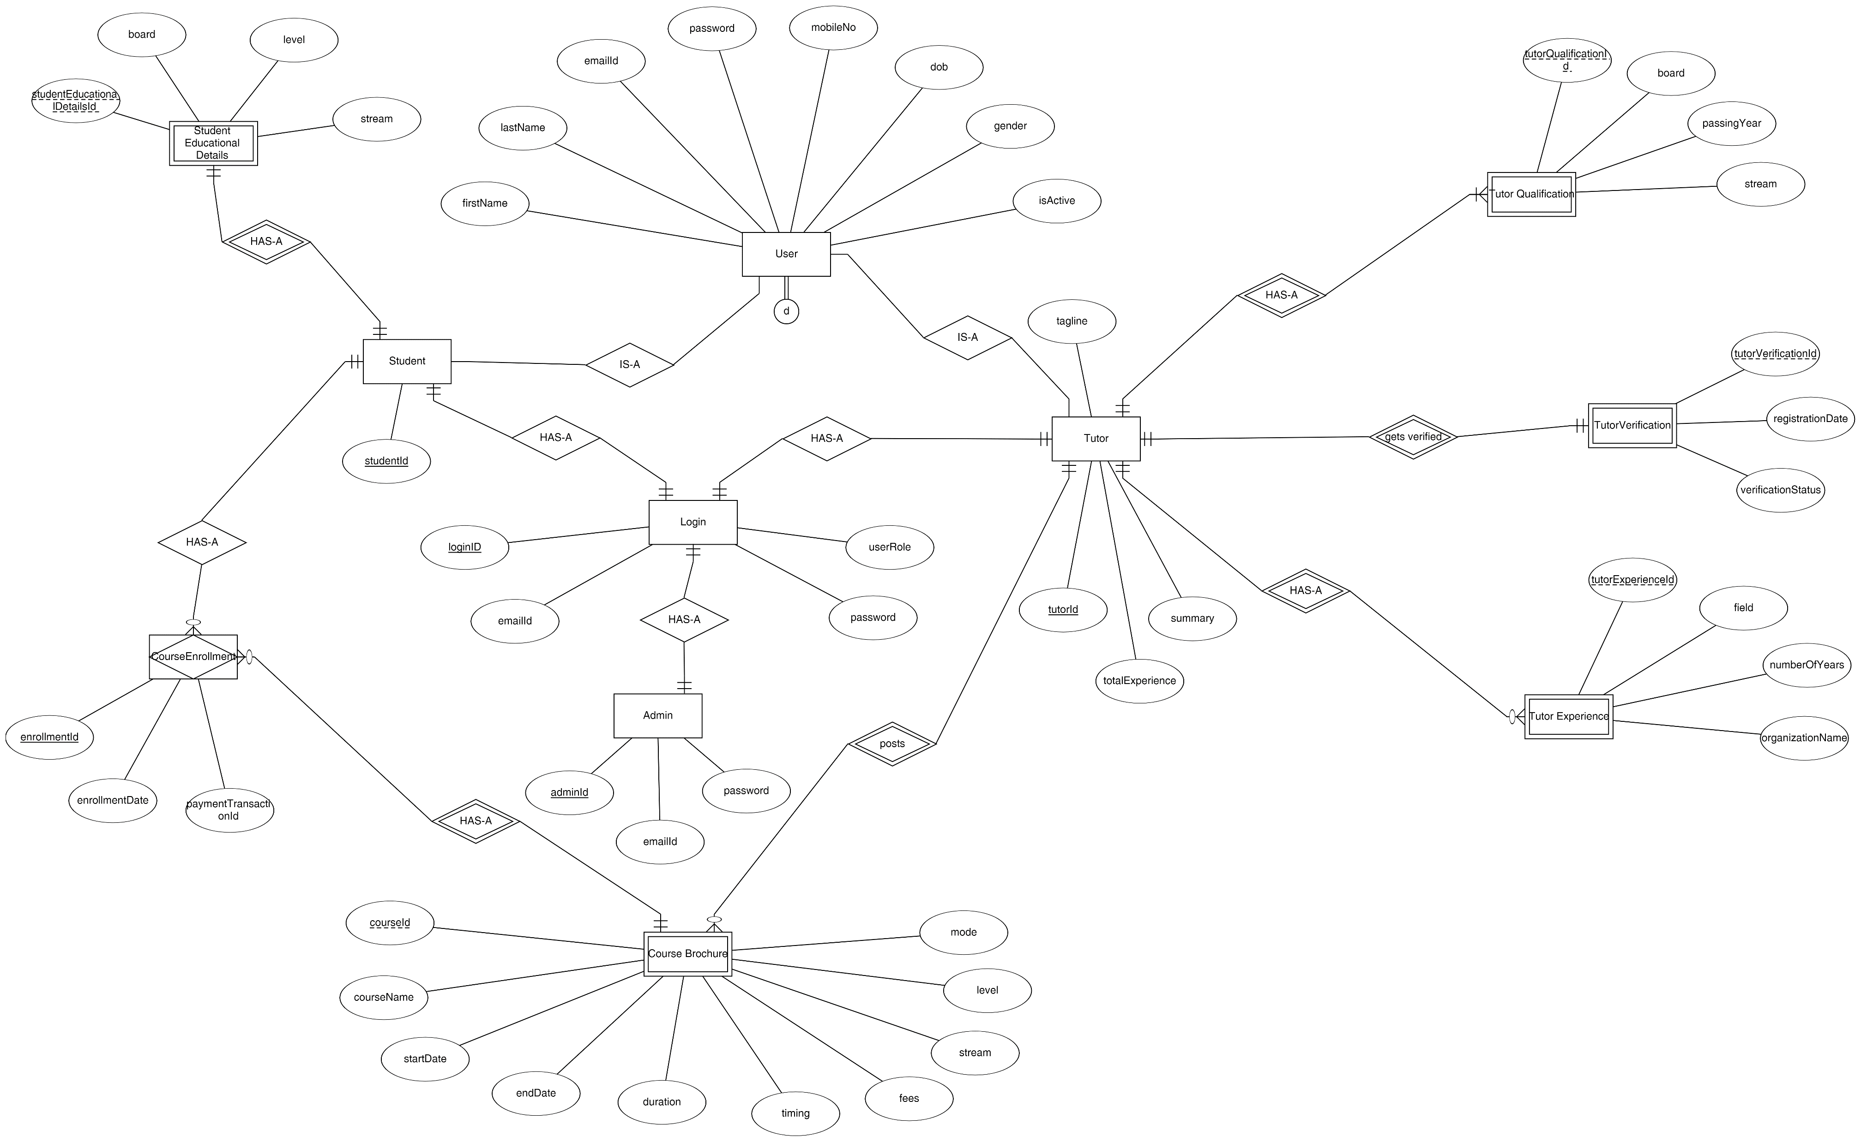
E-R Diagram

Slide 7
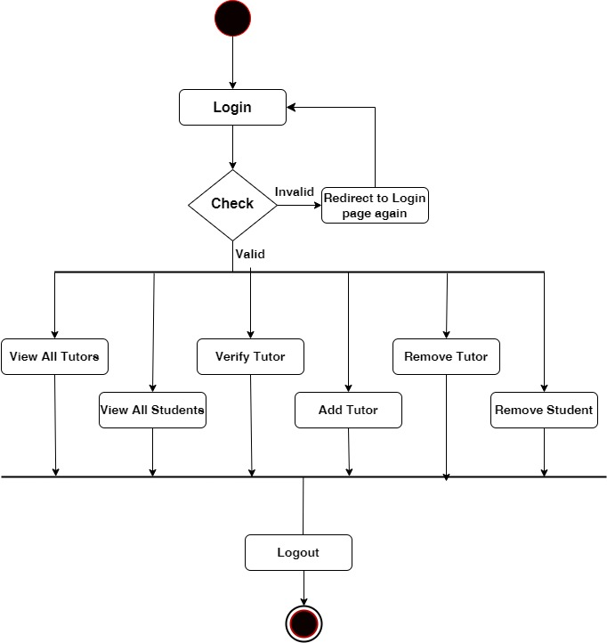
Admin Activity Diagram

Slide 8
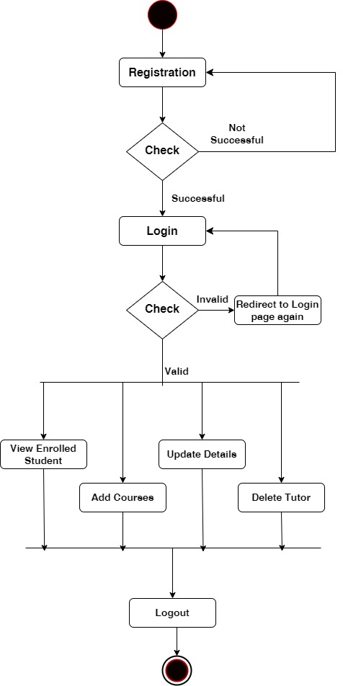
Tutor Activity Diagram

Slide 9
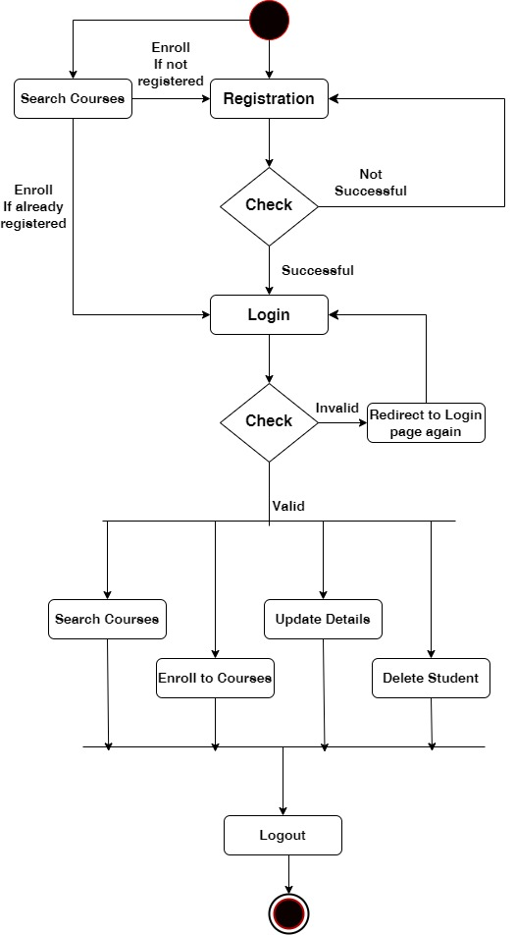
Student Activity Diagram

Slide 10
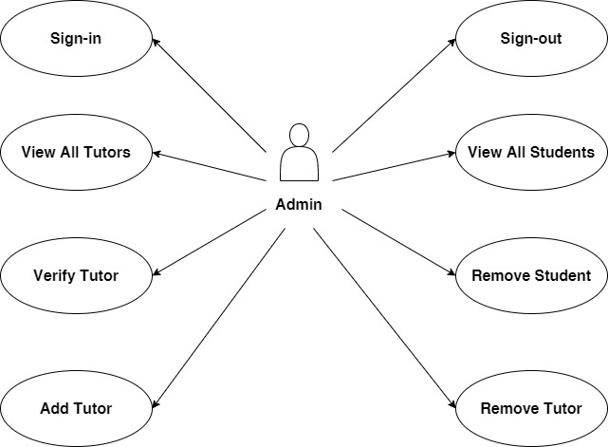
Admin Use Case Diagram

Slide 11
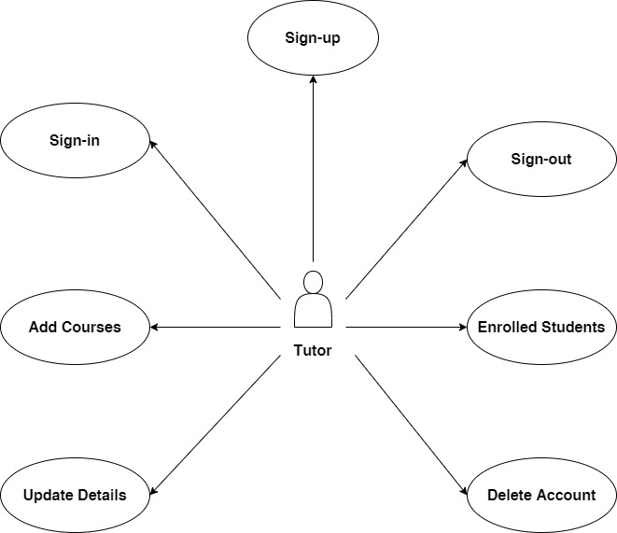
Tutor Use Case Diagram

Slide 12
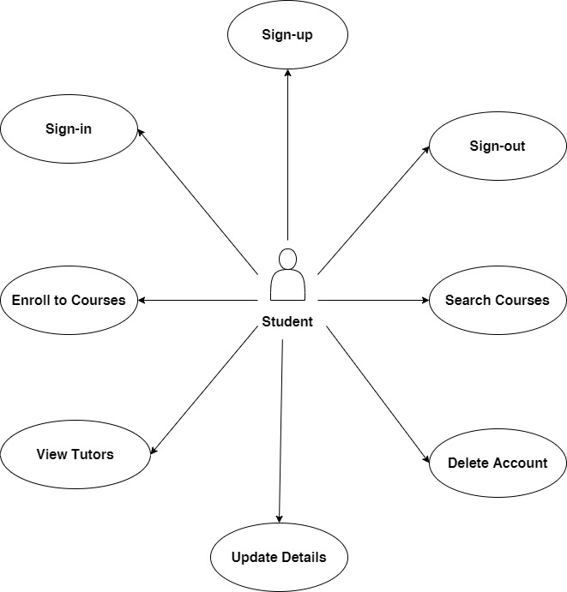
Student Use Case Diagram

Slide 13
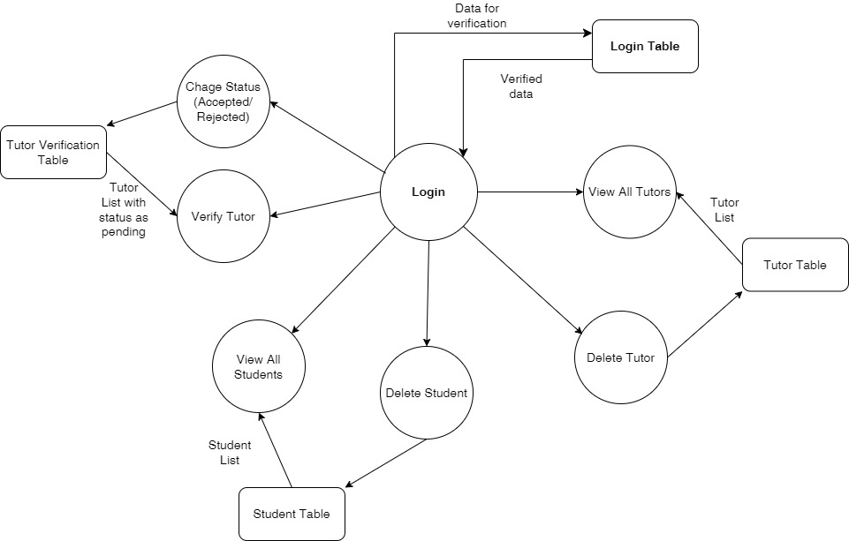
DFD for Admin

Slide 14
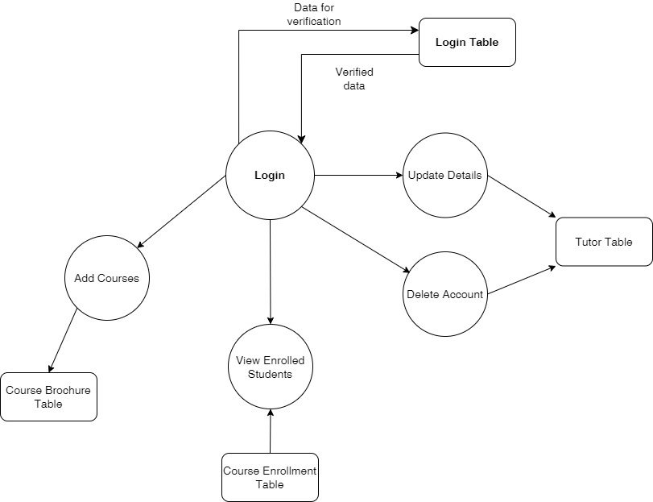
DFD for Tutor

Slide 15
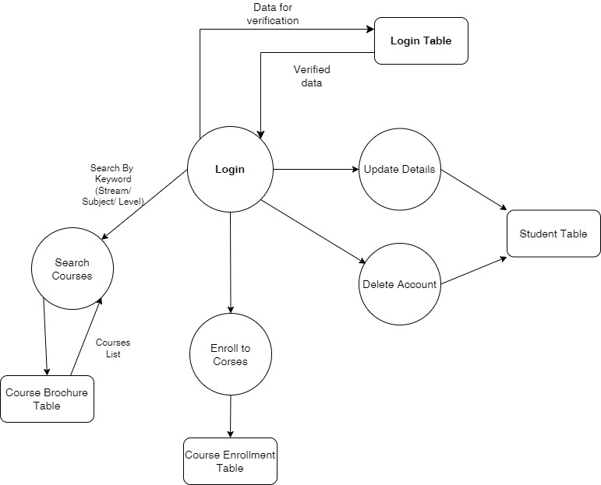
DFD for Student

Slide 16
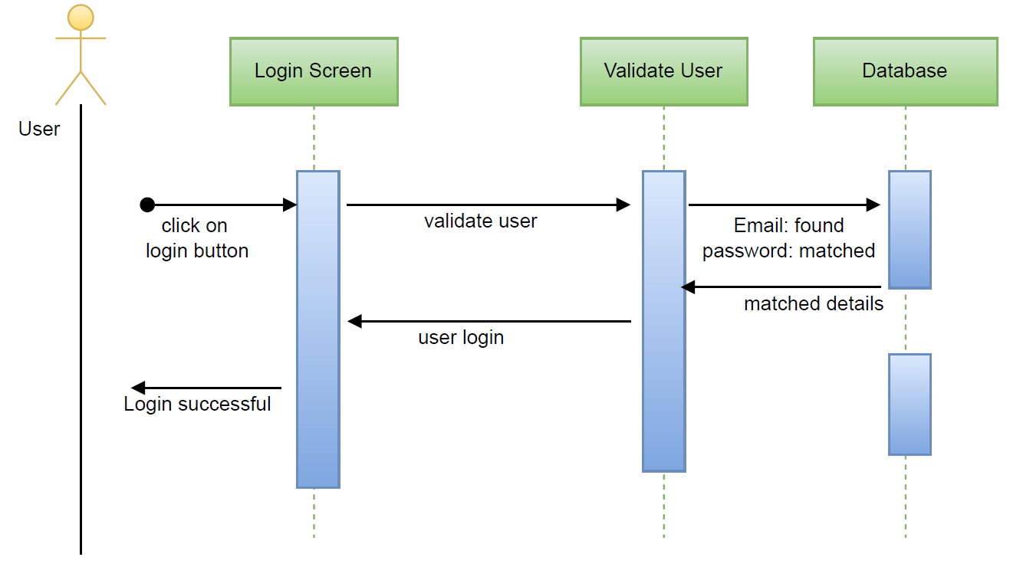
Sequence Diagram for Login

Slide 17
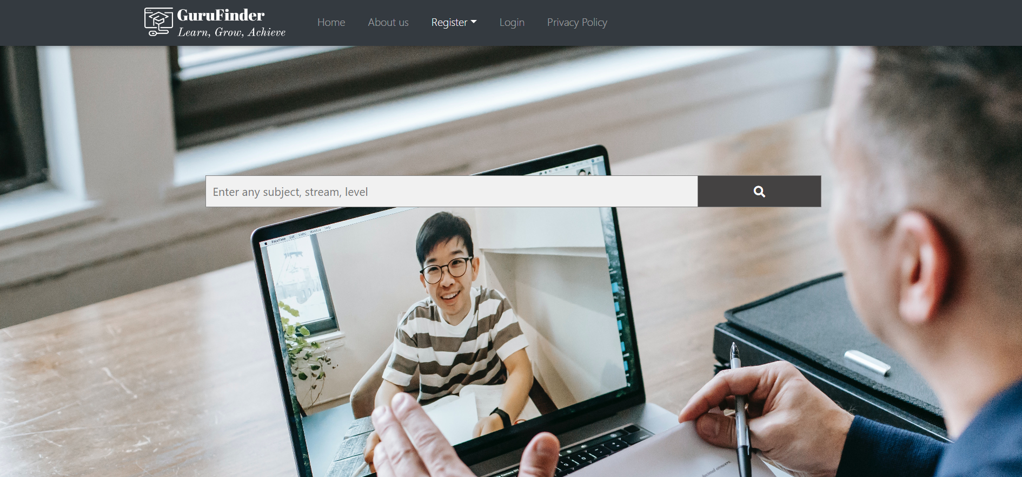
Frontend Screenshots

Slide 18
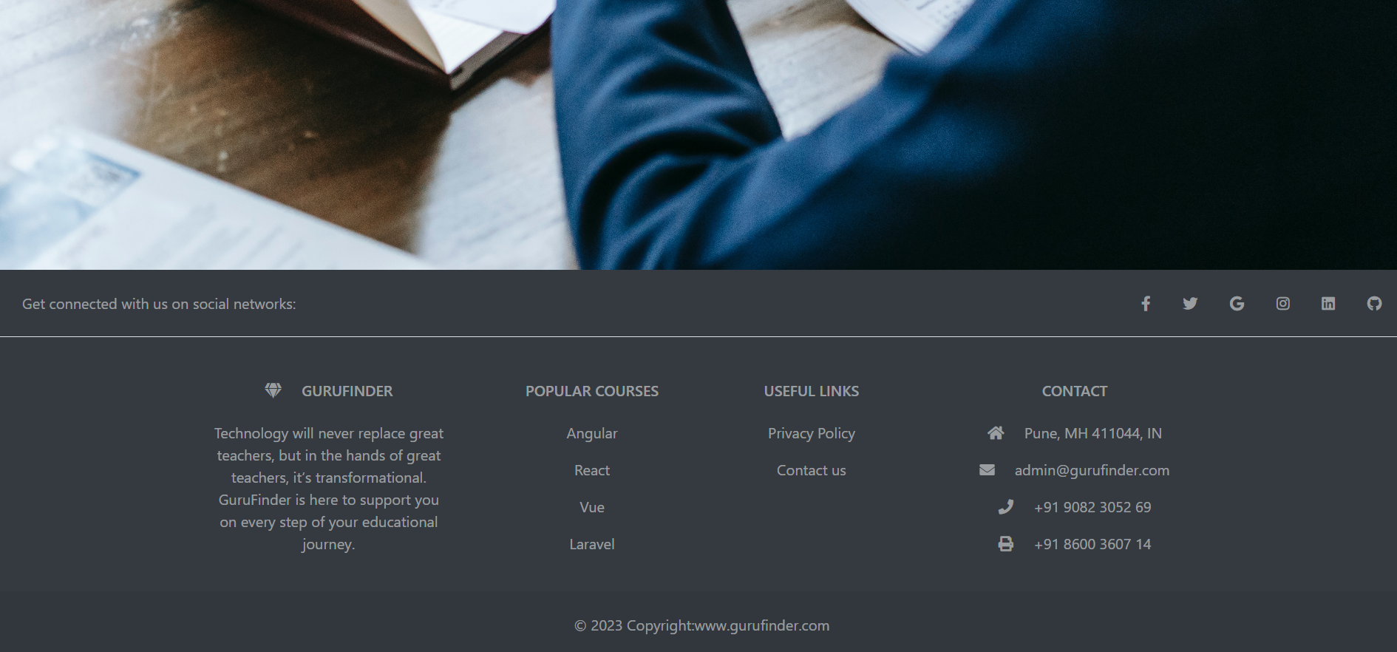
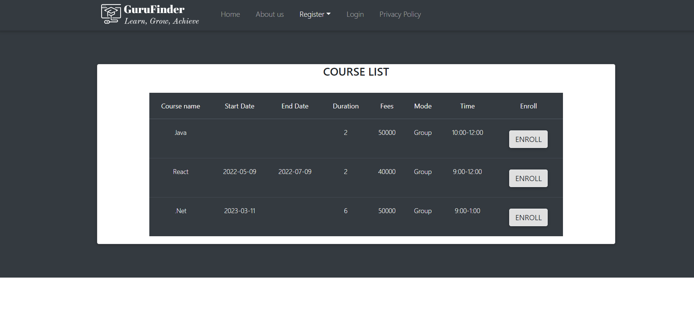

Slide 19
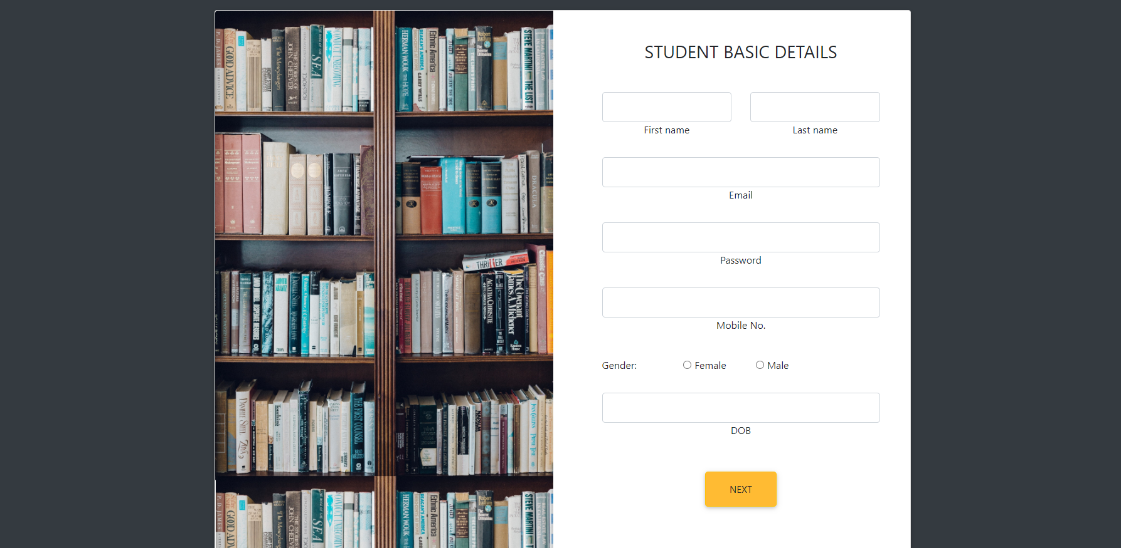
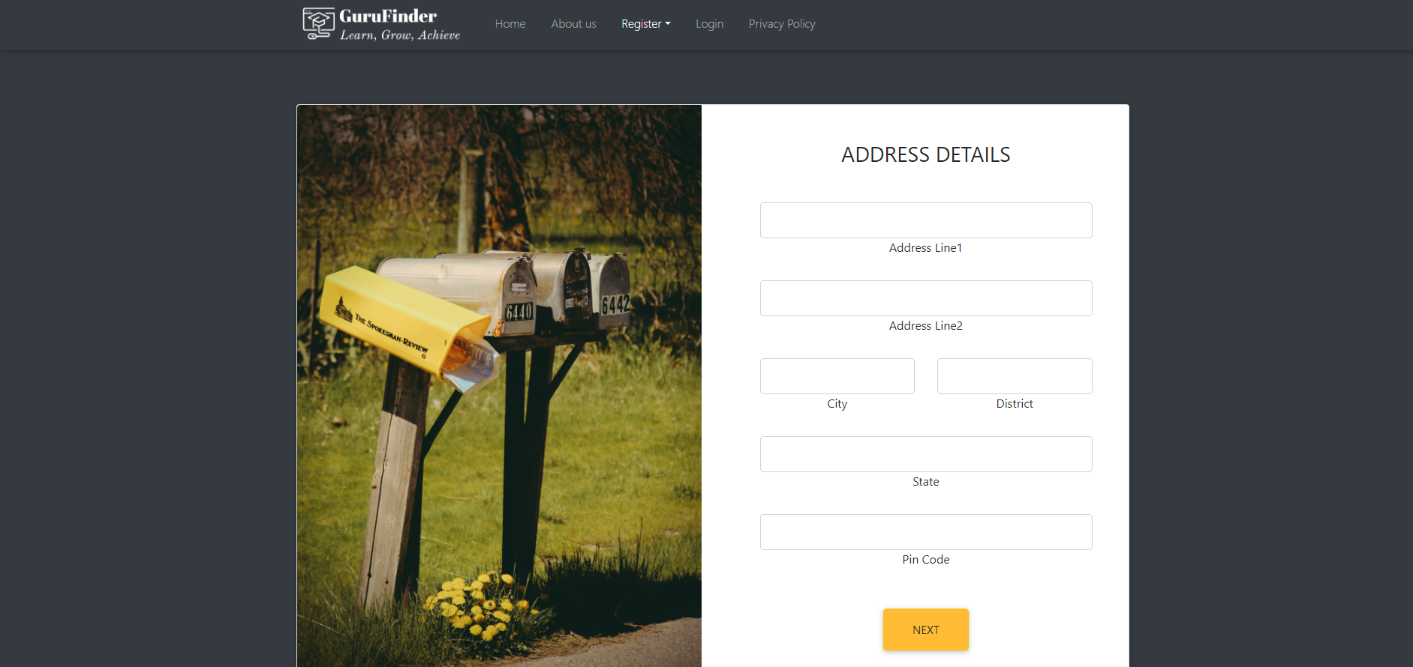

Slide 20
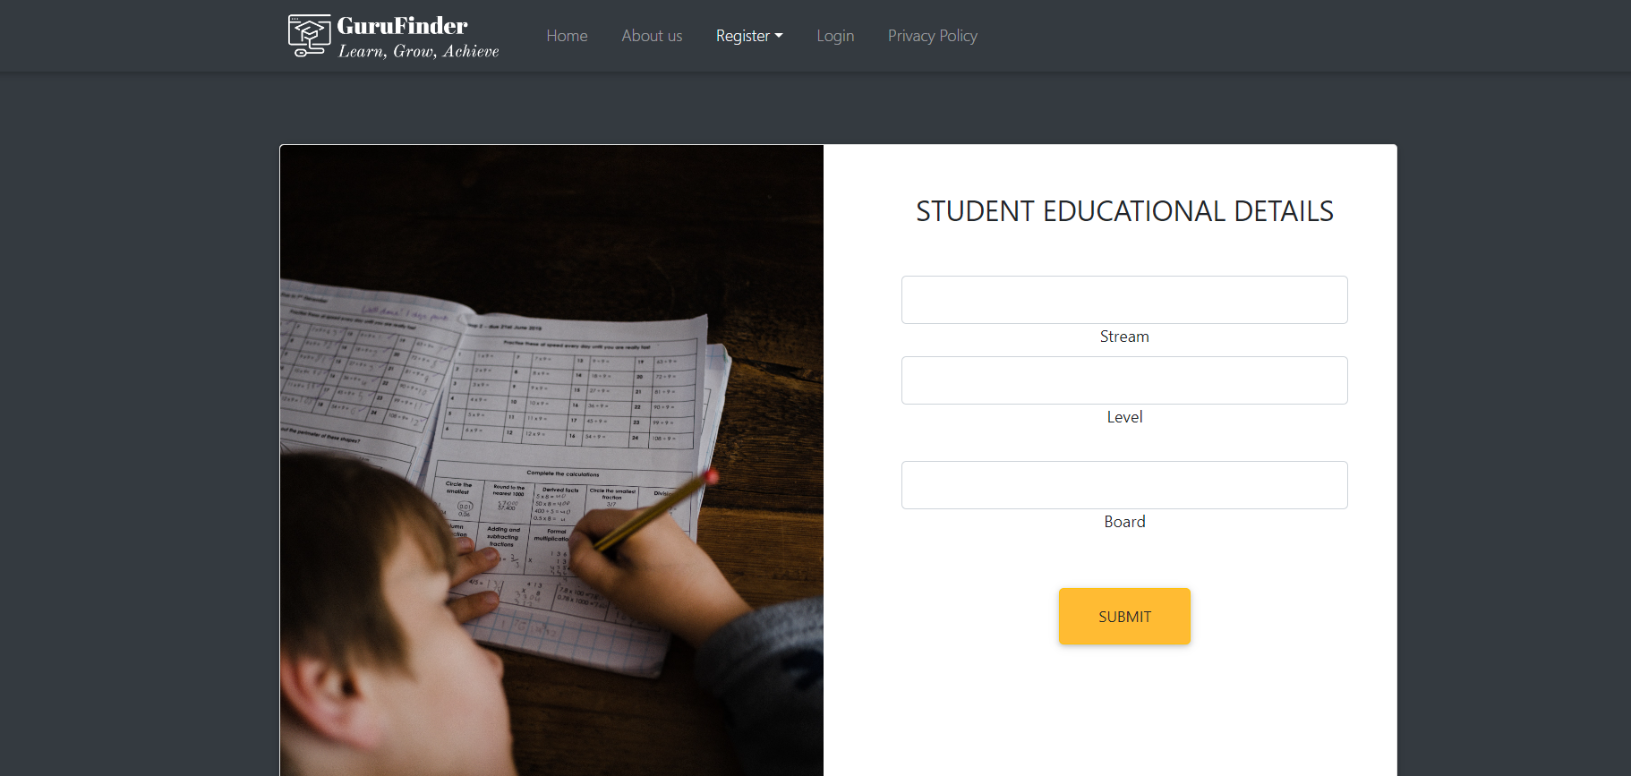
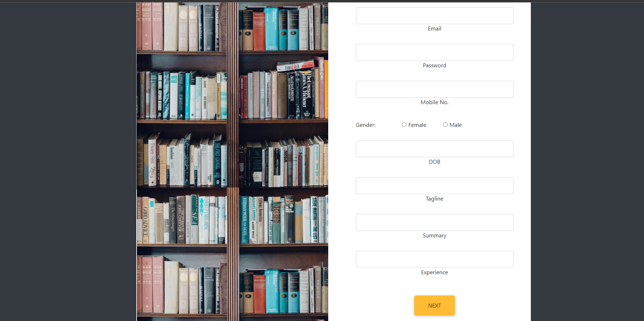

Slide 21
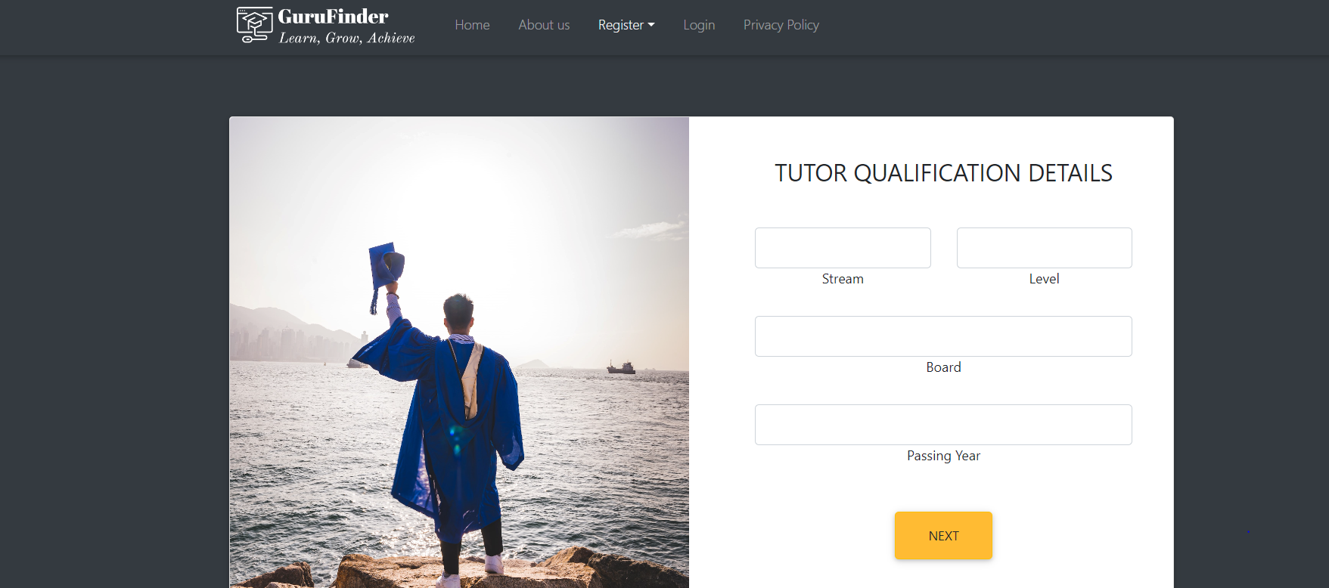
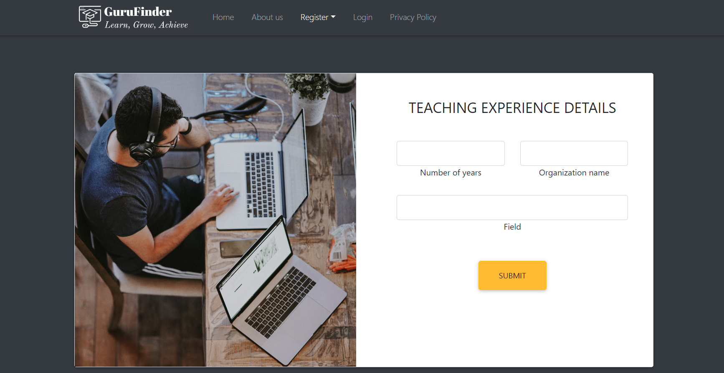

Slide 22
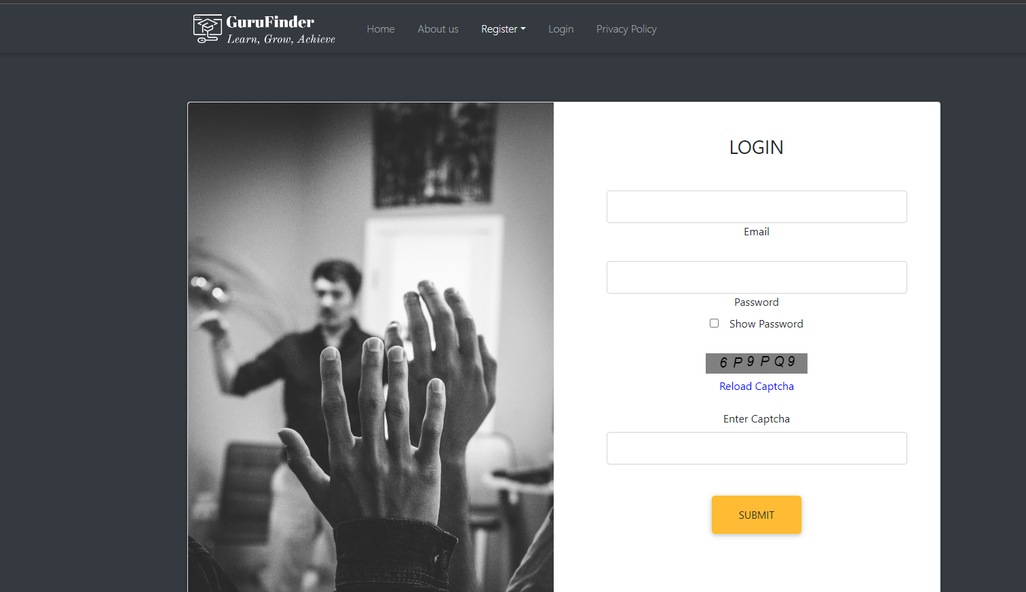

Slide 23
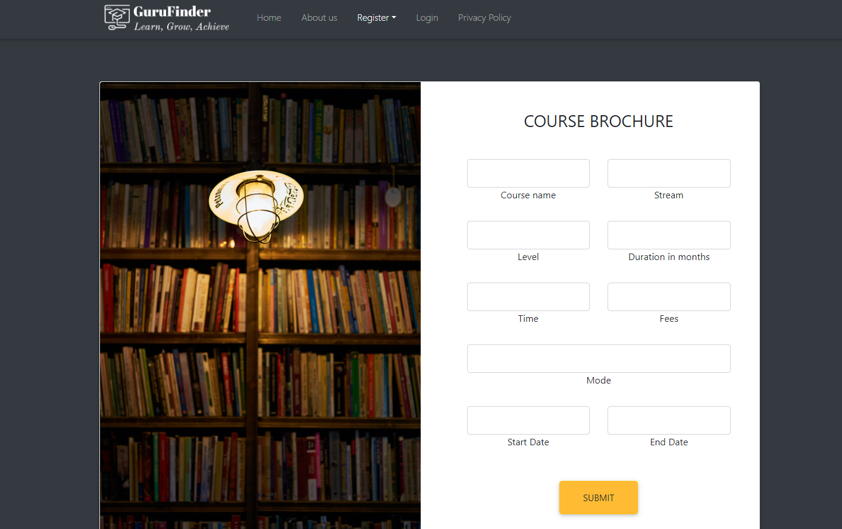

Slide 24
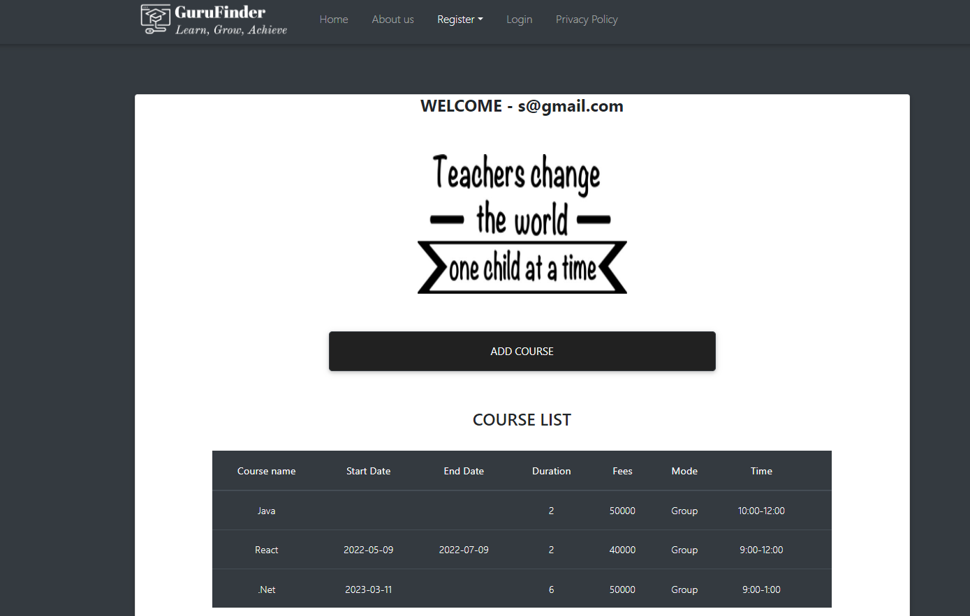

Slide 25
Client side s/w and h/w Requirements
Software Requirements:
- A modern web browser such as Google Chrome, Mozilla Firefox, Safari, or Microsoft Edge
- JavaScript enabled in the web browser
- Internet connection
Hardware Requirements:
- CPU: Intel Core i3 or equivalent
- RAM: 2GB or higher
- Storage: Sufficient storage to save temporary files and cache
- Internet Connection: Broadband connection with minimum 2 Mbps speed

Slide 26
Features
Secure Sign-in and Sign-up (JWT)
Encrypted Password
Captcha while login
Search courses by keyword (stream, subject or level)
Tutor verification done by admin after complete tutor registration
Date and time of course enrollment will be notified by the system
The admin can verify or delete tutor

Slide 27
Conclusion
GuruFinder application can be an effective tool for connecting students with qualified tutors in a convenient and efficient way.
This can lead to improved learning outcomes, increased access to educational resources, and greater flexibility and convenience for both students and tutors.
GuruFinder prioritize safety and security and provide adequate support and resources for students and tutors to ensure a positive and productive learning experience.
Overall, GuruFinder is a well-designed and well-executed tutor finding application. It is a valuable asset for the education community, helping to bridge gaps in access and opportunity and support lifelong learning.

Slide 28
Future Enhancement
Student can choose course as per the mode of teaching (either online or offline)
Student can be able to pay the fees on portal
Student can find the tutors who offer offline courses by selecting location
Student should be able to give reviews to the tutors and these reviews are visible to other users

Slide 29
References
https://www.w3schools.com/
https://getbootstrap.com/
https://mdbootstrap.com/
https://reactjs.org/
https://docs.oracle.com/en/java/javase/11/docs/api/
https://docs.spring.io/spring-boot/docs/current/reference/htmlsingle/
https://docs.oracle.com/javaee/7/api/toc.htm
https://stackoverflow.com/

Slide 30
Thank You

